Slide 1


Art of the Possible
18th October, 2018
Robert Breton
Academic Manager
Data Science Campus
Data Science Campus | datasciencecampus.ons.gov.uk | datasciencecampus@ons.gov.uk | @datascicampus
Public | 1
Notes:
I am robert Breton
I currently lead on developing data science skills and curriculum development within the Campus
Objective: increase data science skills across government from Basic programming -> data wrangling -> analysis -> Machine learning -> building Champions
Today’s format is new – I’d appreciate some feedback at the end if there is time

Slide 2

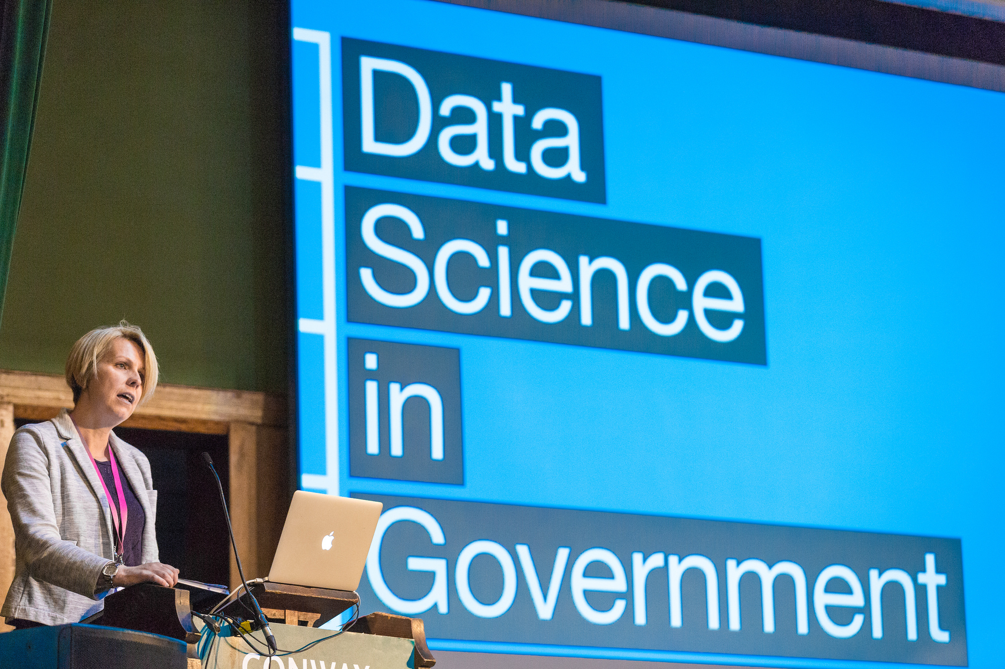
Government Data Science Conference, London, 2017
Overview
What is Data Science?
Example Showcase
Data Science Campus | datasciencecampus.ons.gov.uk | datasciencecampus@ons.gov.uk | @datascicampus
Public | 2
Notes:
This presentation will give a very brief overview of data science
More importantly I will show the ‘Value’ of its application.
This will be expressed by examples from across different fields in government
Finally we can have brief discussion at the end of where (if not already) you can apply data science techniques in your organisation – to add value.

Slide 3
Government Data Science Conference, London, 2017
But first…
… What words come to mind when you hear ‘Data Science’?
Positive
Negative
Not sure?
Data Science Campus | datasciencecampus.ons.gov.uk | datasciencecampus@ons.gov.uk | @datascicampus
Public | 3
Notes:
Early relaxer/engagement
Post-it notes – Positive, Negative, in between
What do you think of when you hear the words Data Science?
Stick post-it notes up onto the wall…pick up on a few of these…ask for clarification…is there anything that could be elaborated on or will we touch on during the session?

Slide 4
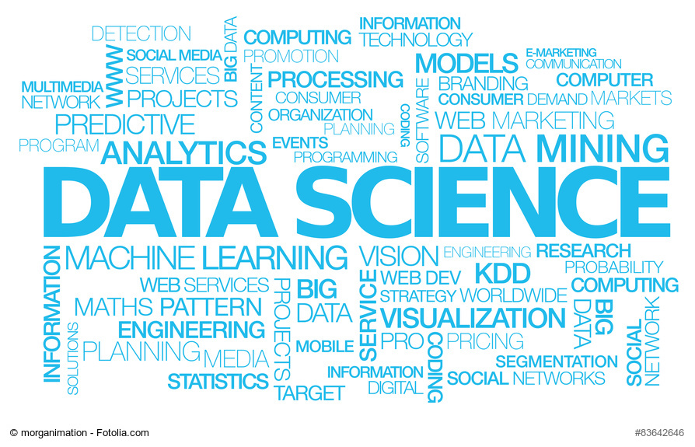
What is Data Science?
“Work that takes more programming skills than most statisticians have and more statistical skills than most programmers have”
David Taylor, http://www.prooffreader.com
Data Science Campus | datasciencecampus.ons.gov.uk | datasciencecampus@ons.gov.uk | @datascicampus
Public | 4
Notes:
This quote sums up the technical position – it’s a bit frivolous, but underlines the fact that the skill set falls between traditional professional groups.
Two fields that data scientists have been grown (software engineers -> DS) (stats -> DS)
Skills:
ingest & wrangle data (meta data.. Unfamiliar data creation)
Explore data: does it make sense?
Form hypothesis (exploratory analysis)
Visualise
Analysis/Machine learning
Product/Value

Slide 5
Dara
What is Data Science?
Computer science
Maths & statistics
Machine learning
“Data Scientists solve complex business problems using a combination of domain expertise, coding knowledge, machine learning and statistics skills on large and varied datasets.”
Government Data Science Partnership
Data science
Danger zone!
Traditional research
Domain expertise
The Data Science Venn Diagram, designed by Drew Conway
Data Science Campus | datasciencecampus.ons.gov.uk | datasciencecampus@ons.gov.uk | @datascicampus
Public | 5
Notes:
What is data science? There is no easy definition...
Volume and complexity.. Requires a broad range of skills
Data Science is a team sport.
I tend to think of a data science team as opposed to an individual with all of the above skills. In the past I have worked on what I would call operational data science. Combination of specialists. Data scientists typically working on prototypes, and working closely with the domain experts/product owners. Software engineers (or those data scientists with SE expertise) work to productionise products/pipelines.
Combined skills teams is how we have delivered key projects within the ONS. For example,VAT tax data into national accounts.
Policy colleagues have a very important role to play in the “Subject Area Expertise” bit of the diagram – data science will really add value when we bring subject expertise. (use fine arts example within the VAT frame)

Slide 6

Making Better Use of Data
Challenges Ahead
Size of modern data sets
Quality
Rate of Acquisition
Ethics
Prof. David Hand, Imperial College London
Data Science Campus | datasciencecampus.ons.gov.uk | datasciencecampus@ons.gov.uk | @datascicampus
Public | 6
Notes:
Size – new sources are HUGE, gigabytes of data per day. At present, our systems are not geared to store or manipulate such enormous quantities of data.
Quality – What are the biases in the data? The weaknesses? How do we validate the data against something else? How do we know whether the data is good/correct?
Rate of acquisition – with so much data arriving so frequently, how do we begin to summarise and extract value from it?
Ethics – This is a very serious issue for government, which has strong reputational risk around public trust. Should government be collecting the sort of information that we can get from social media, for example? E.g. Food Standards Agency proposal (ruled unethical) to track social media posts of restaurant visitors for a few days to see if they got sick, to better target food inspections. This is probably a step too far down the “intrusive” road, albeit with the noblest of intentions. Cabinet Office released ethical guidance for data science in government this summer 2017, while the National Statistician’s Data Ethics Committee looks at what is and isn’t appropriate for official statistics. This is a minefield, and if we get it wrong it could be catastrophic for public trust.

Slide 7
Making Better Use of Data
Challenges Ahead
Opportunities
Size of modern data sets
Quality
Rate of Acquisition
Ethics
Scope of new data acquisition methods
The rate of acquisition
Insight from linking and merging datasets
Prof. David Hand, Imperial College London
Data Science Campus | datasciencecampus.ons.gov.uk | datasciencecampus@ons.gov.uk | @datascicampus
Public | 7
Notes:
This may take us outside our comfort zone but let’s embrace the opportunities this new world offers…
Scope – the ways in which we can acquire data are expanding hugely. Real time data feeds, smart phone traces, social media posts, comments on websites, “rumble strips” on roads, the Internet of Things….
Rate – many sources update every second, or even more frequently. Think about the real time tube map. This gives us an unprecedented opportunity to measure things very quickly and very often.
Linking and merging – we can add the most value by linking new data with existing sources (which we know a lot about). In this way, we can potentially increase explanatory power and drive insight.

Slide 8
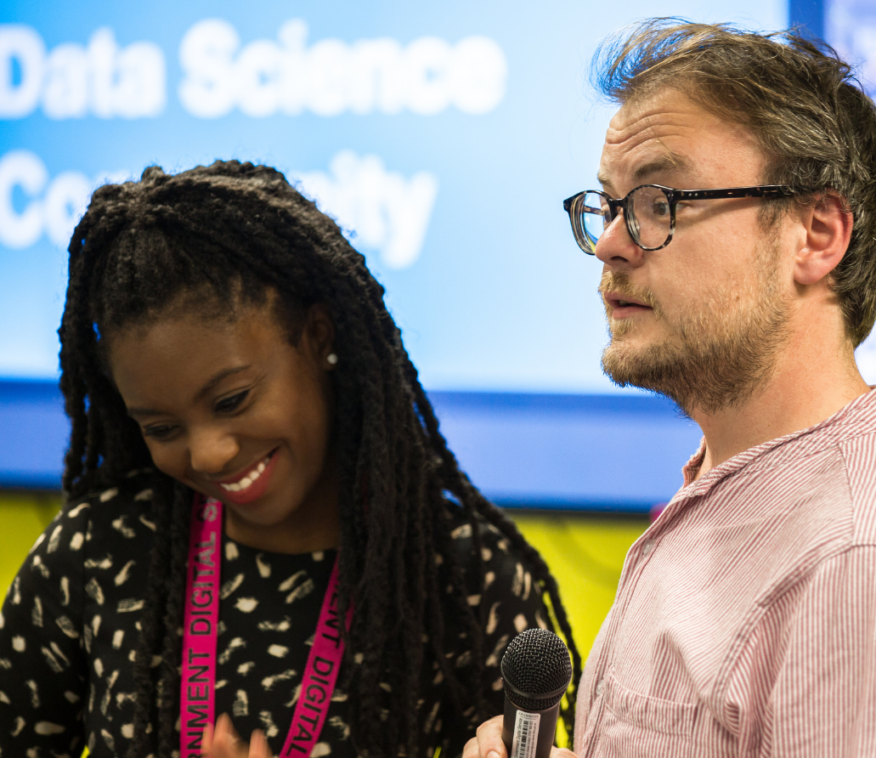
Examples of
Data Science in Government
Dawn Duhaney and Gareth Llewellyn from GDS at the Government Data Science Community of Interest Meet-up London, November 2017
Data Science Campus | datasciencecampus.ons.gov.uk | datasciencecampus@ons.gov.uk | @datascicampus
Public | 8

Slide 9
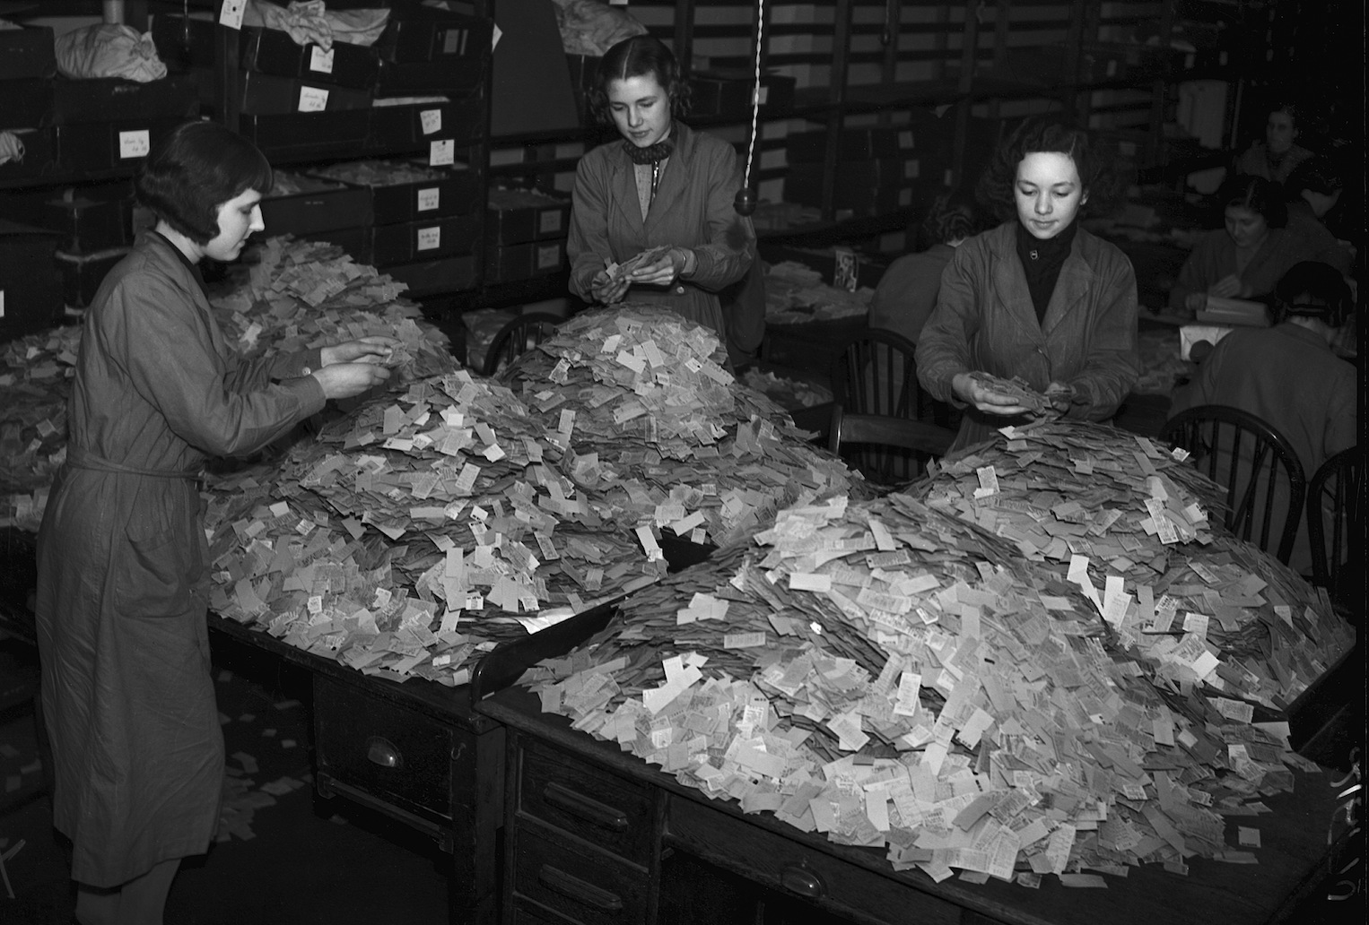
London Transport workers manually examine over 4 million tickets to identify most and least popular routes, March 1939
Gerry Cranham/Fox Photos/Hulton Archive/Getty Images
Data Science Campus | datasciencecampus.ons.gov.uk | datasciencecampus@ons.gov.uk | @datascicampus
Public | 9
Notes:
Data Analysis is nothing new.
In 1939 London Transport wanted to optimise their network, increasing the frequency of trains on the most popular routes, but first they needed to understand what the most popular routes were. They collected over 4 million ticket stubs showing the journey and over 3 days workers manually sorted them. The analysis itself took 6 months.

Slide 10
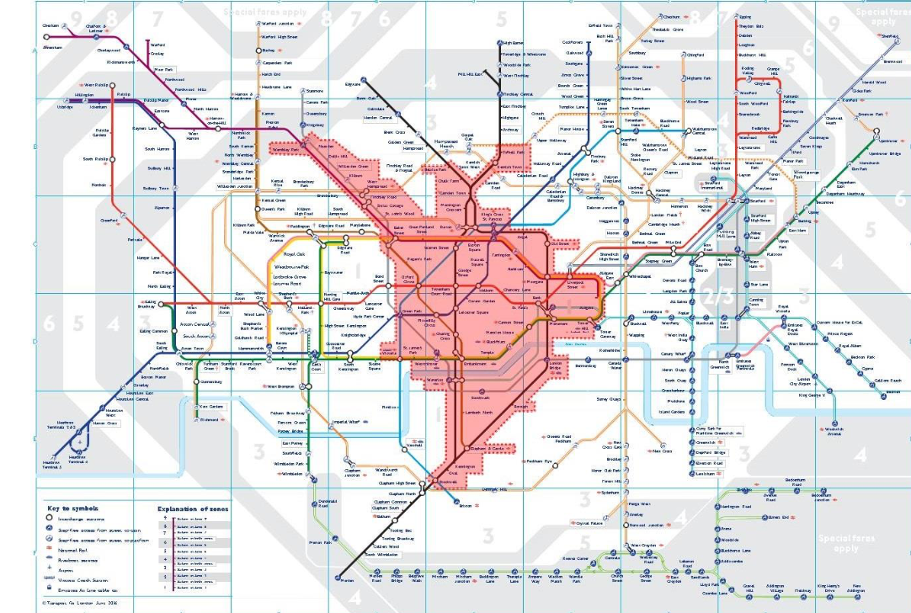

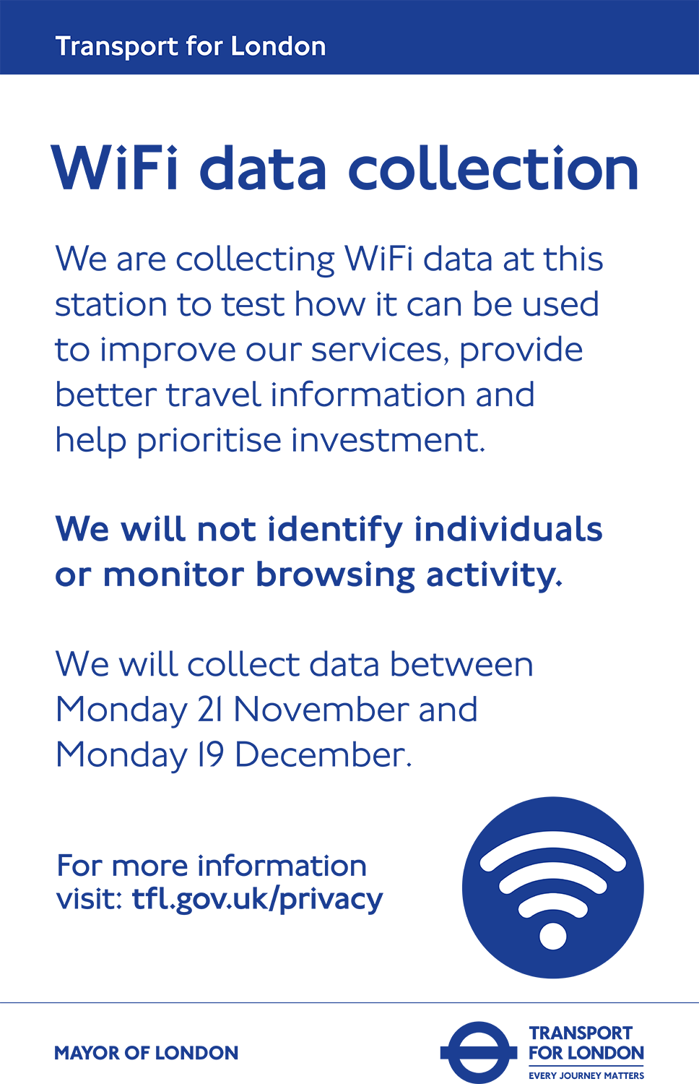
Data Science Campus | datasciencecampus.ons.gov.uk | datasciencecampus@ons.gov.uk | @datascicampus
Public | 10
Notes:
In 2016 Transport for London (TFL) wanted to do the same analysis, however the increased volume of traffic, over 5 million commuters per day, made this a daunting task. In addition, the increased complexity of the Tube network meant that it was no longer enough to simply measure what station people started and ended their journey in – it was more important to understand the route they took and what stations they changed at.
Oyster cards and contactless payment systems only record the start and end of the journey, so TFL needed a new way to measure traffic. They decided to use something almost every commuter had, a mobile phone.
Most phones today are also data devices, and are normally set to try and connect to wifi networks when they can. TFL installed dummy wifi hotspots in every station, and as commuters stepped on to the platform, their phone would ping the dummy hotspot. This would happen in every station, on every platform along their journey, giving TFL a map of the route they took.
TFL advertised this collection in every station, giving commuters full information on how the test was being run, how their data would be used, and how to opt out (simply by switching off the Wifi connection on their phones).

Slide 11
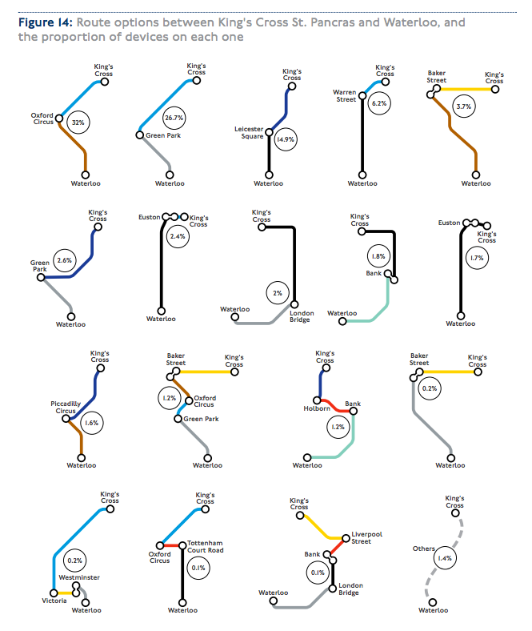
Data Science Campus | datasciencecampus.ons.gov.uk | datasciencecampus@ons.gov.uk | @datascicampus
Public | 11
Notes:
The data collected was then analysed by a team of data scientists who were able to map out the most congested and least used routes. Here are some of the results they published last year, showing all the journeys taken by commuters between Waterloo station to Kings Cross
[You can make a joke here about the folks who went via London Bridge, bank and Liverpool street, bottom row, second from the right. Were they lost or drunk?]
the point here is that data analytics is nothing new. What is new is the volume and complexity of available data, and the advances in computing power and technologies available to analysts. To take advantage of both, that’s where data science comes in.

Slide 12

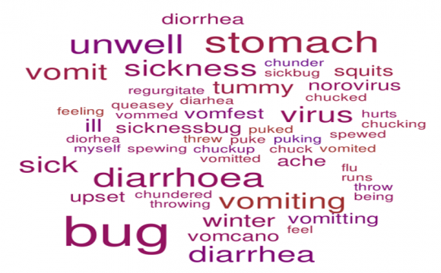
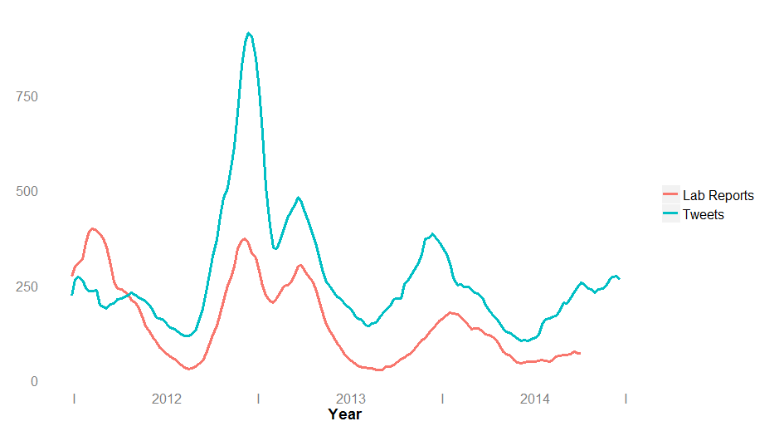

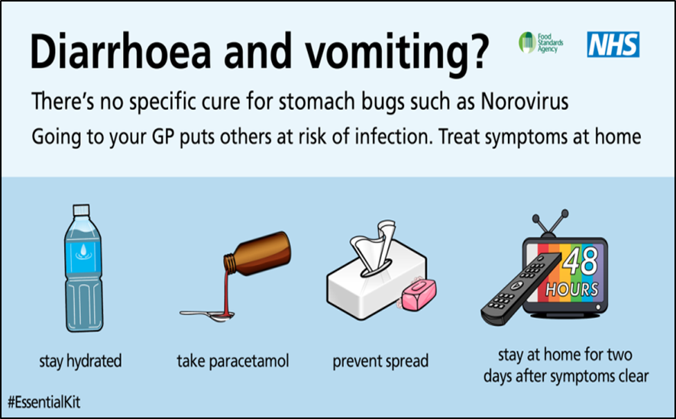
Predicting Viral Outbreaks
2.8M
Cases of Norovirus per year in the UK
£120M
Estimated cost to the country in lost working hours due to Norovirus
Fig 1. Wordcloud of Norovirus Keywords
Fig 2. Norovirus Keywords in Tweets compared to reported incidents
£20K
Total cost of the project, including publicity campaign
(David Millson and Callum Staff, Food Standards Agency)
Data Science Campus | datasciencecampus.ons.gov.uk | datasciencecampus@ons.gov.uk | @datascicampus
Public | 12
Notes:
Words on the left were crowd sourced within FSA. They also had to ‘eliminate’ some words that may have been linked to other situations like a hangover or pregnancy.
Amazingly, plenty of people feel the need to share their disease symptoms on Twitter!
Assuming that lab reports are themselves a good indicator of Norovirus cases in the community, this chart demonstrates that tweets including “sickness bug” and related terms are a similarly good indicator, reproducing not just the seasonality but features such as the double peak in the winter of 2012/13 and the relative heights of the peaks. For this graph, both lab reports and volumes are smoothed by averaging over seven week periods.
The cost of this project was small – about 20k, including publicity campaign and analyst time. Norovirus itself costs the country about £120 million in lost working hours, with 2.8 million cases per year. We only need to prevent 500 of those to recover the costs of the project!

Slide 13

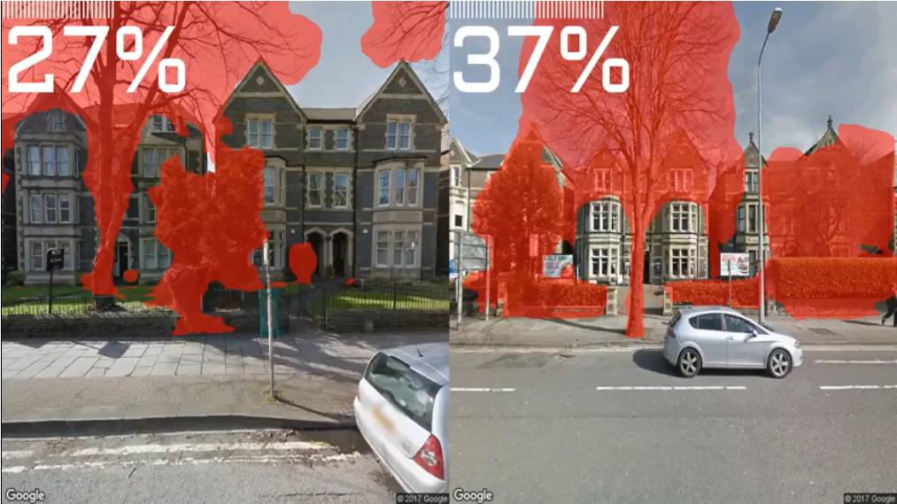
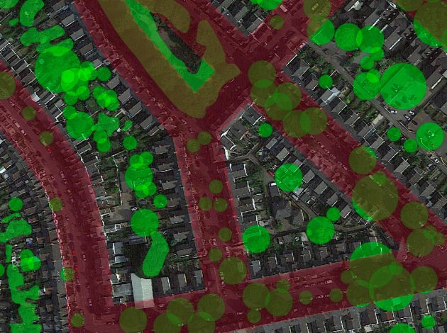

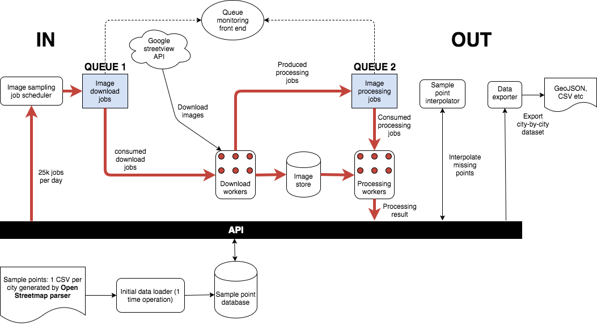
Measuring the Urban Forest
£1B
Annual benefit of UK trees removing 1.5 billion kilograms of air pollution per year
17M
Google Streetview images to be processed over 22 months, analysed at 10m intervals
25K
Images processed per day, from the 110 largest cities and towns in England and Wales
Image Processing Pipeline
(Phil Stubbings, Data Science Campus, ONS)
Data Science Campus | datasciencecampus.ons.gov.uk | datasciencecampus@ons.gov.uk | @datascicampus
Public | 13
Notes:
Urban forest - trees and vegetation in the streets, parks, gardens, balconies, etc
Trees provide a wide variety of social, environmental and economic benefits - e.g. can improve social cohesion, encourage exercise, filter air, reduce flooding, provide habitat for wildlife – Improve Well Being
Project aim: to automatically count and classify trees in cities, using computer vision and alternative data sources such as Google Street View
An example from the Data Science Campus: applying machine vision techniques to automatically detect vegetation (Google Street View) in urban environments (where urban environment would be determined by ONS Geographical categorisations). The information created is then converted and visualised using Leaflet.
Who is interested in this? ONS Natural Capital Team, who were working in collaboration with Defra. This is now an alternative data source that will feed ONS environmental accounts.
What will happen with this: Used in Policy making and targeting tree planting programmes by town and county planners.

Slide 14

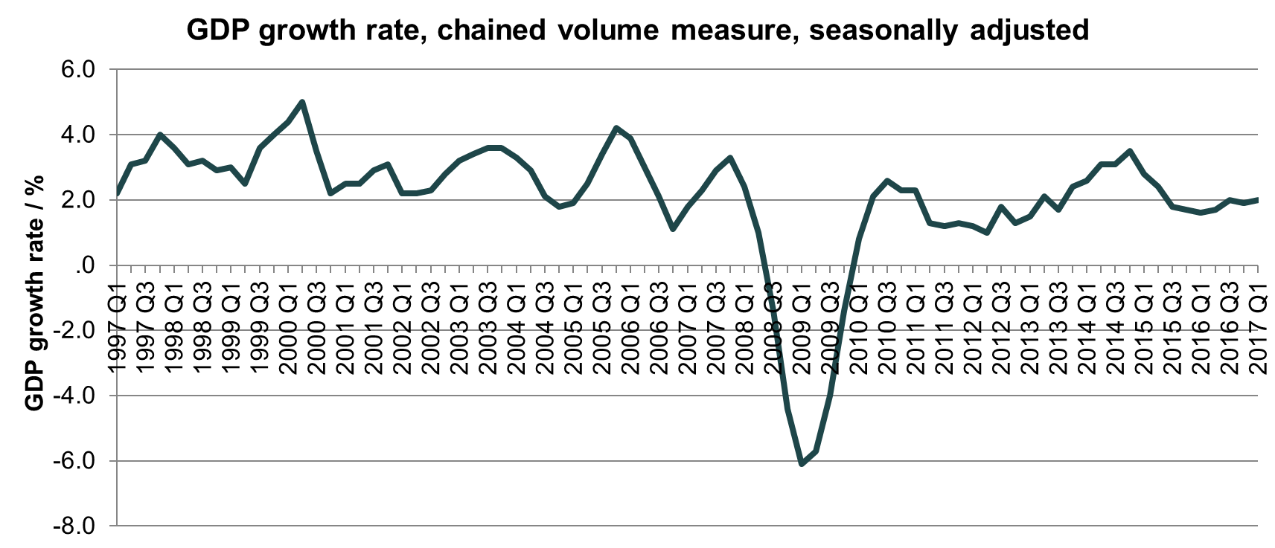
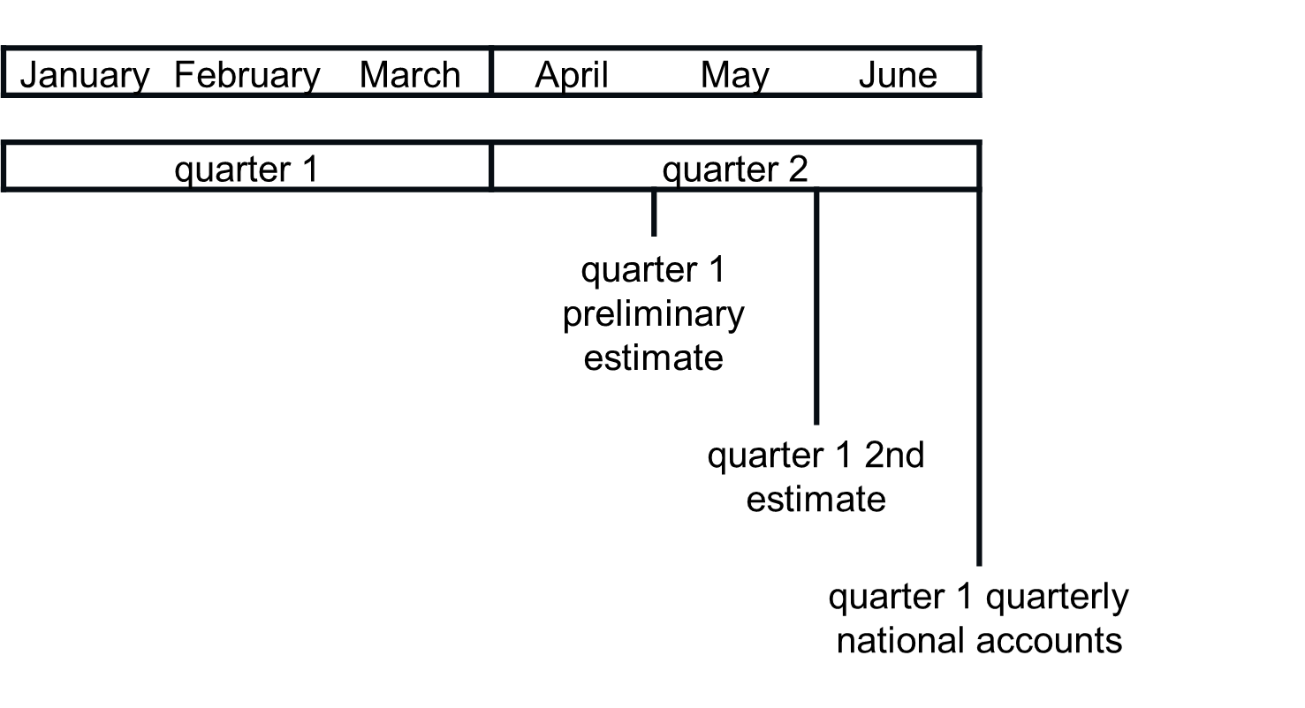
Early Indicators of GDP
-6%
Change in UK GDP between first quarter of 2008 and second quarter of 2009
5 years
Early Intervention
Fig 1. UK GDP Growth Rate
Length of time from 2008 for the UK economy to return to pre-recession size
£12B
Early Indicators
Estimated value for earlier identification of 2008 downturn
Fig 2. ONS National Accounts Publication Timetable
(Data Science Campus, ONS)
Data Science Campus | datasciencecampus.ons.gov.uk | datasciencecampus@ons.gov.uk | @datascicampus
Public | 14
Notes:
What are we trying to improve?
Following the financial downturn in 2008/09 a need was identified for a means of predicting behaviour of economic measures at an earlier point than the official calculations
How might this be useful?
This indicator may provide advance warning of large change in behaviour of GDP

Slide 15
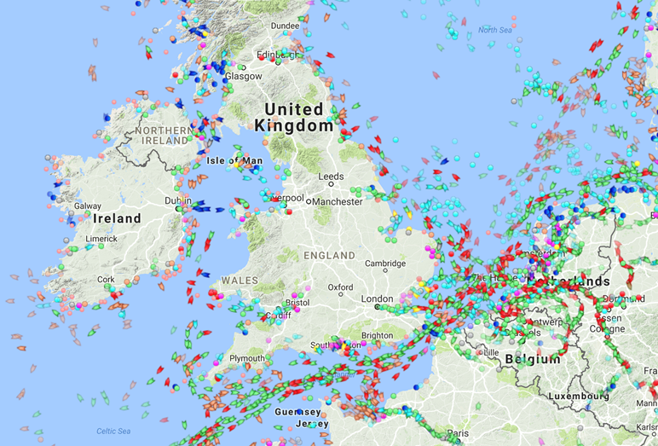
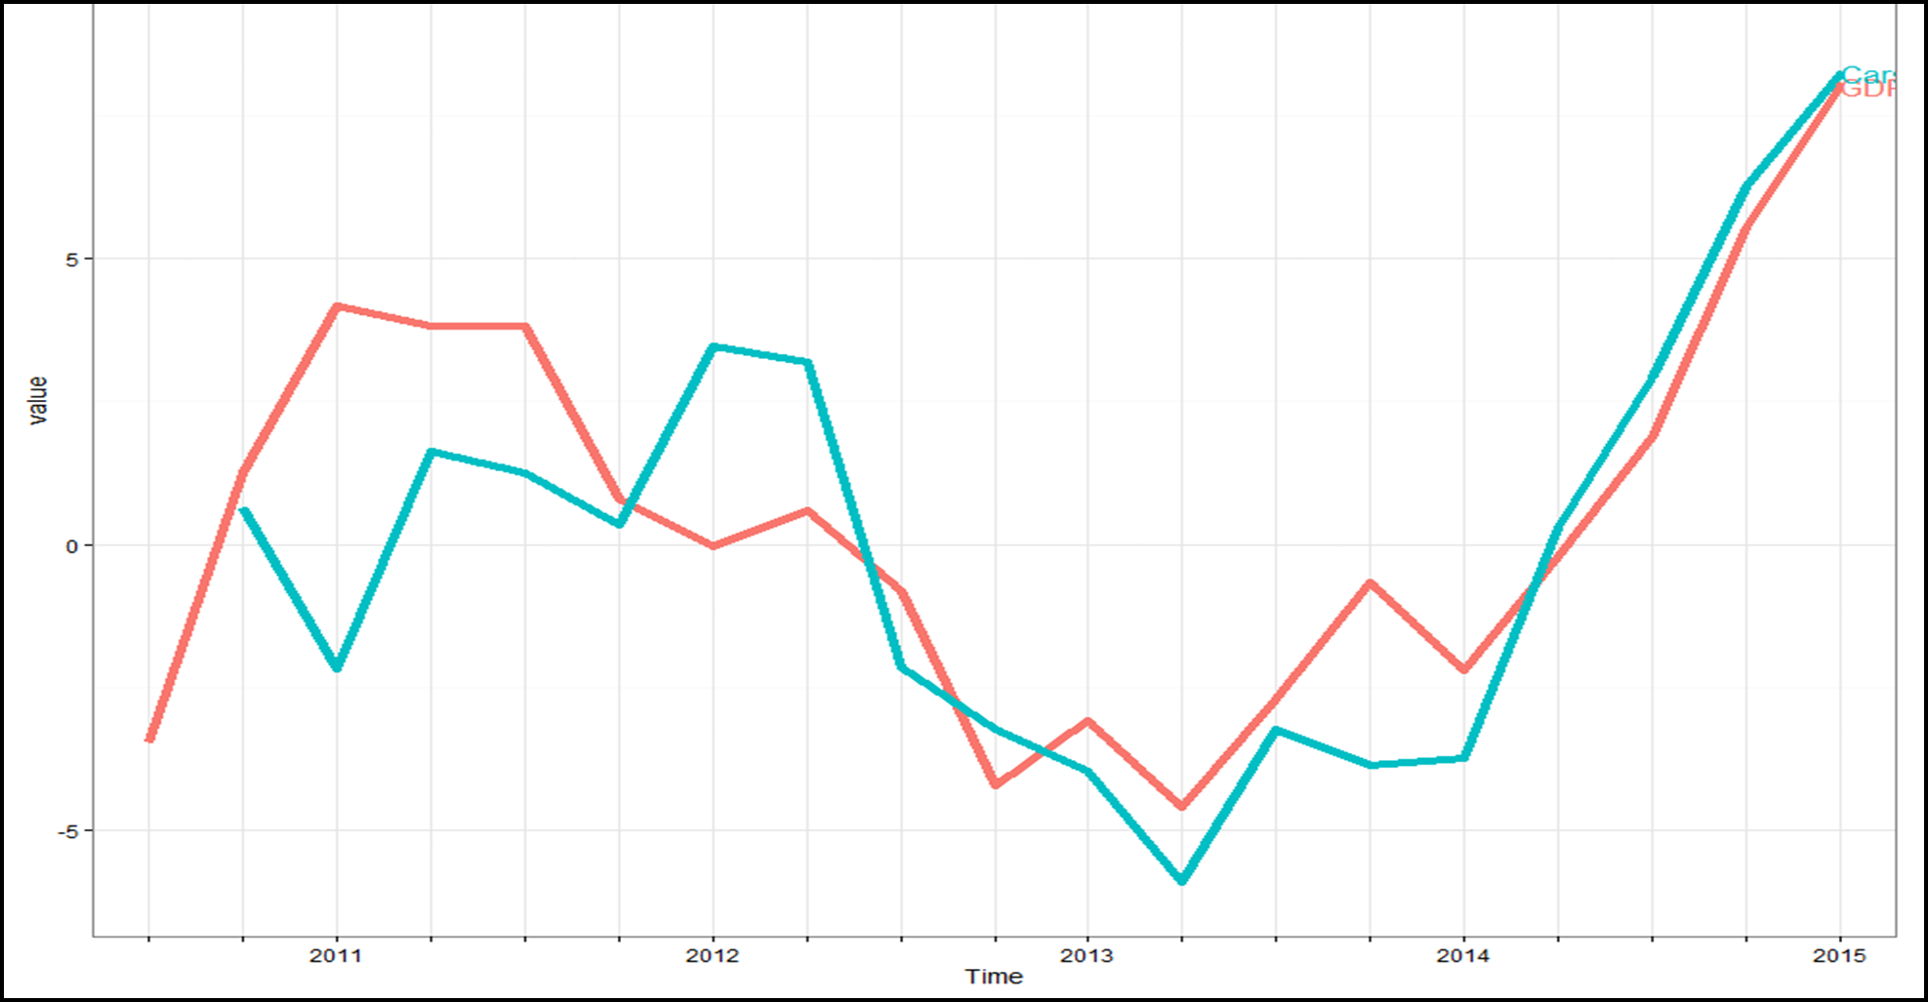
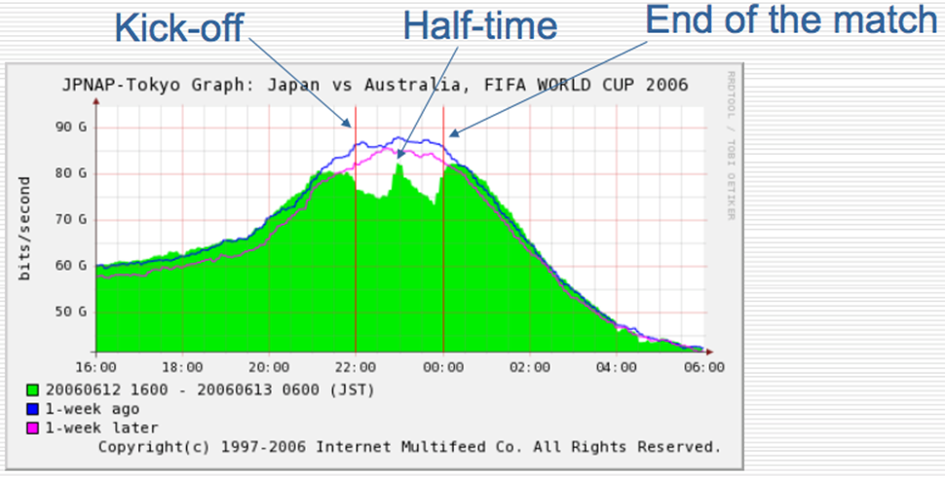
Early Indicators of GDP
-6%
Change in UK GDP between first quarter of 2008 and second quarter of 2009
VAT turnover returns
5 years
HMRC VAT Data
AIS Ship Location
Length of time from 2008 for the UK economy to return to pre-recession size
£12B
Estimated value for earlier identification of 2008 downturn
Road Traffic
Broadband Traffic
(Data Science Campus, ONS)
Data Science Campus | datasciencecampus.ons.gov.uk | datasciencecampus@ons.gov.uk | @datascicampus
Public | 15
Notes:
What is the impact in terms of public good? (if any)
This project can allow a more immediate understanding of and reaction to changes in the economy.
This is to be shared with ONS National Accounts via delivery of the codebase used in the prototype and a blog will be written for publication on the Campus website.
Who is using? This indicator is not currently in use. It may be used by ONS once a full suite of indicators is developed as a separate project.
Any awards or feedback (e.g., comments, tweets)? Unaware of any current feedback.

Slide 16
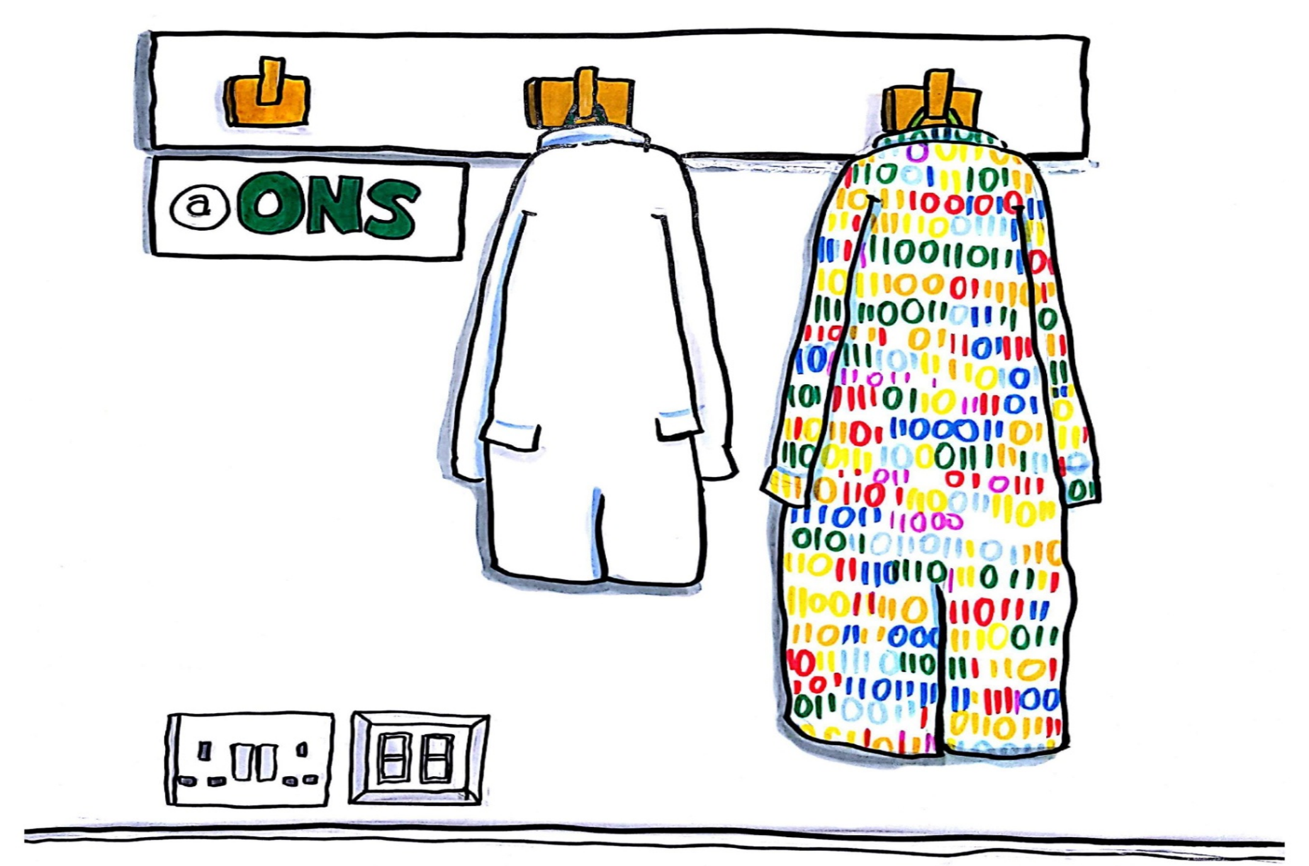
Robert Breton
Academic Manager
ONS Data Science Campus
Email: datasciencecampus@ons.gov.uk
Web: datasciencecampus.ons.gov.uk
Twitter: @DataSciCampus
Image credits: ONS stock: (Dave Johnson); GDS pp2,3,9,13,18; FSA p14,15; Gerry Cranham / Fox Photos / Hulton Archive / Getty Images p6; drawnalism p14
Data Science Campus | datasciencecampus.ons.gov.uk | datasciencecampus@ons.gov.uk | @datascicampus
ONS Data Science Campus, October 2017
Public | 16

